Slide 1
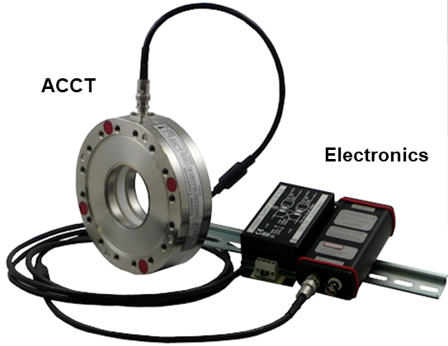
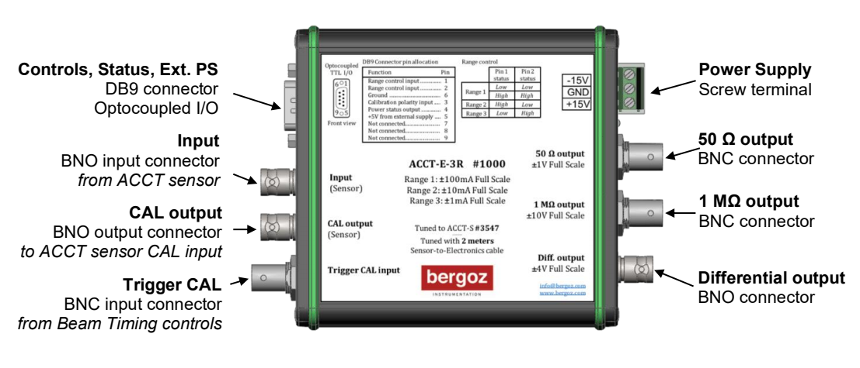
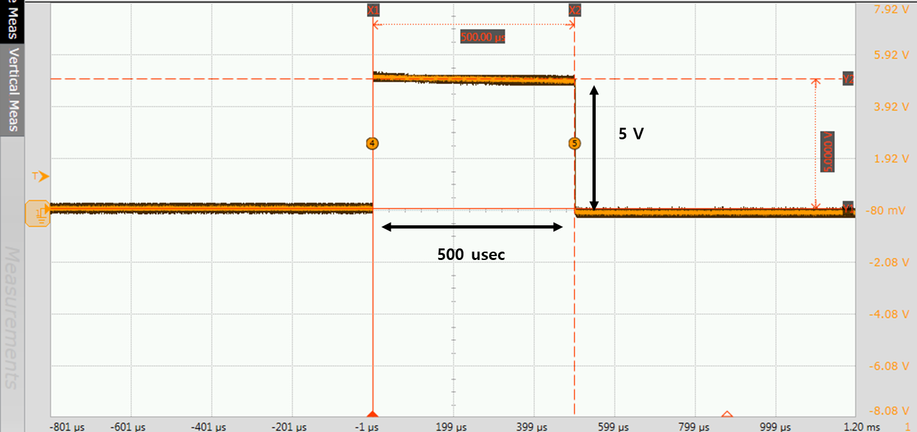
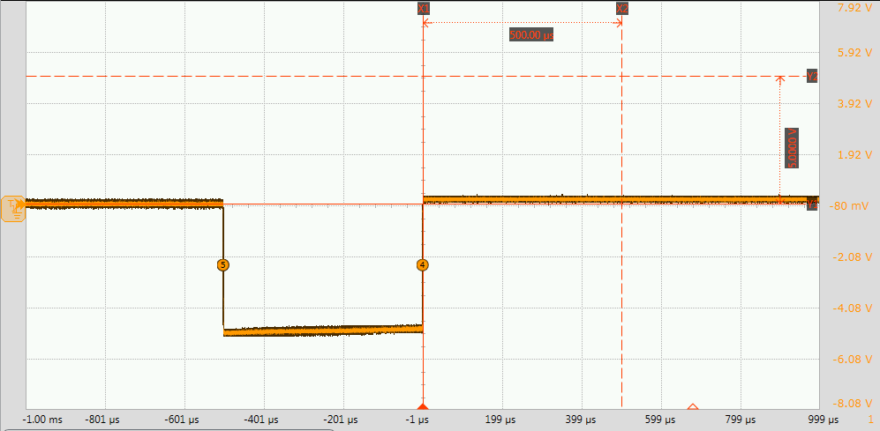
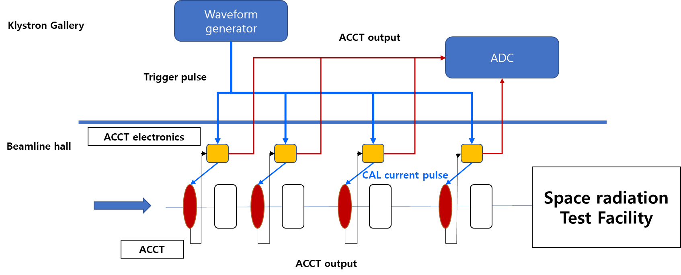
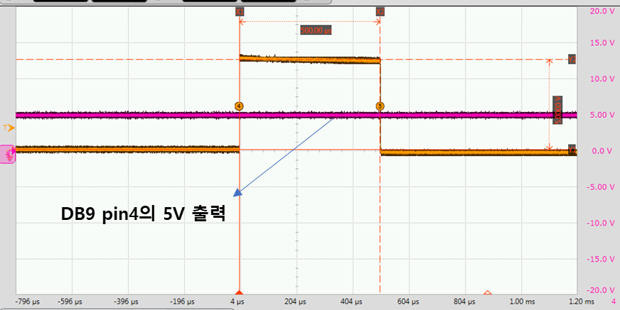
KNS Spring 2022, Jeju 2022.5.18~20
Test for New ACCT Electronics and Plan for ACCT System
at KOMAC Space Radiation Testing Beamline
Sang-Pil Yoon*, Young-Gi Song, Han-Sung Kim, Hyeok-Jung Kwon
Korea Multipurpose Accelerator Complex, Korea Atomic Energy Research Institute, Gyeongju, Korea
* spyun@kaeri.re.kr
Introduction & Motivation
Since 2013 the operation of the 100-MeV proton linear accelerator has been started, the ACCT (AC-current transformer) has been a main beam current measurement system of the 100-MeV proton linear accelerator and its beamline. ACCT (AC-current transformer) is typical non-destructive current measurement method, can measure the macro-pulse current of the charged particle beam without any disruption [1]. And then, ACCT is superior to measure the beam pulses longer than tens of sec with high sensitivity and strong voltage signal, even down to 1 mA. Recently, new ACCT electronics is introduced and tested, which have new functionality of the in-situ calibration. In this paper, new upgraded ACCT system will be introduced.
Test of New ACCT Electronics
Current ACCT System
Specification
Main feature of New ACCT Electronics
Full Scale Range | Factory preset
Ratio accuracy error | < 0.1% FS
Lower cutoff | < 3Hz
Upper cutoff | 1 MHz
Rise time | 350 ns (10 – 90%)
Manufacturer | Bergoz (France)
3 selectable full scale ranges (1 / 10 / 20 mA)
3 outputs : High impedence, 50Ω and differential
Integrated calibration current source
Remote controllable by TTL
ACCT consist of toroidal sensor head and electronics
ACCT is main beam current monitor at 100 MeV proton linear accelerator
Test and calibration set-up
Test and calibration set-up
The calibrated pulse is generated by the ACCT-E-RM-3R and injected into the sensor calibration winding via the sensor CAL input connector
Current pulse amplitude : 50 % of the full scale of the selected range
( 10mA full scale => calibration current is 5 mA)
The calibrated current pulse length is defined Trigger signal length
(trigger signal length = calibration current pulse length)
The trigger signal has to be TTL level.
Calibration result old ACCT sensor head
CAL Trigger to ACCT-E-RM-3R : 3.3V, 500 usec by waveform generator
ACCT output voltage : measured by Oscilloscope
Preset ACCT range : 10V / 20 mA
CAL current pulse amplitude : 10 mA (50% of the selected range)
5V, 500 usec current pulse measured
(for input : 10 mA /10V)
Current pulse adjusted by input TTL pulse length
Old ACCT has no signal degradation
Remote control by TTL
Future Plan of ACCT system
Polarity control
Summary & Future Plan
In-situ calibration of ACCT without disassembling and test stand
Easy adjustment to polarity by remote control
Easy adjustment to full scale range remotely (3 selectable range)
Power status monitoring of ACCT electronics
Periodic response check and calibration of ACCT system
Remote control function
Range control
Calibration polarity
Power status output
(+5V from external power supply)
Schematics future Installation at the space radiation test facility
Range control
Power status monitoring
Pin 1 status | Pin 2 status | Range
Low | Low | Range 1
High | High | Range 1
High | Low | Range 2
Low | High | Range 3
This work has been supported by the National Research Foundation of Korea (NRF-2021M2D1A1045615).

